Slide 1
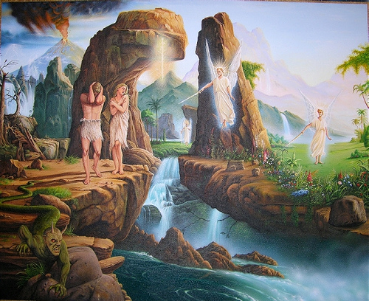
Genesis 3.14-24
artwork by Yezid Chiang Huaman

Slide 2
Genesis 3.14 NIV: So the LORD God said to the serpent, “Because you have done this, Cursed are you above all livestock and all wild animals! You will crawl on your belly and you will eat dust all the days of your life.
humiliation and vulnerability
a reminder that creatures rebelled
Genesis 3.15 NIV: “And I will put enmity between you and the woman, and between your offspring and hers; he will crush your head, and you will strike his heel.”

Slide 3
Genesis 3.16 NIV: To the woman he said, “I will make your pains in childbearing very severe; with painful labor you will give birth to children. Your desire will be for your husband, and he will rule over you.”

Slide 4
Genesis 3.16 NIV: To the woman he said, “I will make your pains in childbearing very severe; with painful labor you will give birth to children. Your desire will be for your husband, and he will rule over you.”
literally: “toward your husband, your desire”
literally: “toward you, its desire”
Genesis 4.7 NIV:
“…if you do not do what is right,
sin is crouching at your door. It desires to have you,
but you must rule over it.”

Slide 5
Genesis 3.17-19 NIV: To Adam he said, “Because you listened to your wife and ate fruit from the tree about which I commanded you, ‘You must not eat from it,’ Cursed is the ground because of you; through painful toil you will eat food from it all the days of your life. It will produce thorns and thistles for you, and you will eat the plants of the field. By the sweat of your brow you will eat your food until you return to the ground, since from it you were taken; for dust you are and to dust you will return.”

Slide 6
Genesis 3.17-19 NIV: To Adam he said, “Because you listened to your wife and ate fruit from the tree about which I commanded you, ‘You must not eat from it,’ Cursed is the ground because of you; through painful toil you will eat food from it all the days of your life. It will produce thorns and thistles for you, and you will eat the plants of the field. By the sweat of your brow you will eat your food until you return to the ground, since from it you were taken; for dust you are and to dust you will return.”
woman: עִצָּבוֹן in childbirth
man:
עִצָּבוֹן in work

Slide 7
God
Genesis 3.17-19 NIV: To Adam he said, “Because you listened to your wife and ate fruit from the tree about which I commanded you, ‘You must not eat from it,’ Cursed is the ground because of you; through painful toil you will eat food from it all the days of your life. It will produce thorns and thistles for you, and you will eat the plants of the field. By the sweat of your brow you will eat your food until you return to the ground, since from it you were taken; for dust you are and to dust you will return.”
Man
Family
Creation

Slide 8
Genesis 3.20-21 NIV: Adam named his wife Eve, because she would become the mother of all the living. The LORD God made garments of skin for Adam and his wife and clothed them.
the protagonist’s promise [v.15]
people’s initial response [v.20]
the first step of fulfillment [v.21]

Slide 9
Genesis 3.9-19: A Chiasm…
A. Man [vv.9-12]
B. Woman [v.13]
C. Serpent / Satan [vv.14-15]
B. Woman [v.16]
A. Man [vv.17-19]

Slide 10
In Genesis 3.15 NIV, God said to Satan,
“…I will put enmity between you and the woman,
and between your offspring and hers; זֶרַע = “seed.”
he will crush your head, and you will strike his heel.”

Slide 11
In Genesis 3.15 NIV, God said to Satan,
“…I will put enmity between you and the woman,
and between your offspring and hers;
he will crush your head, and you will strike his heel.”

Slide 12
In Genesis 3.15 NIV, God said to Satan,
“…I will put enmity between you and the woman,
plural “seed”
and between your offspring and hers;
he will crush your head, and you will strike his heel.”

Slide 13
In Genesis 3.15 NIV, God said to Satan,
“…I will put enmity between you and the woman,
and between your offspring and hers;
singular “seed”
he will crush your head, and you will strike his heel.”

Slide 14
Genesis 3.20 NIV: Adam named his wife Eve, because she would become the mother of all the living.
= Life Giver
from Latin Eva,
which translated
חַוָּה in Hebrew

Slide 15
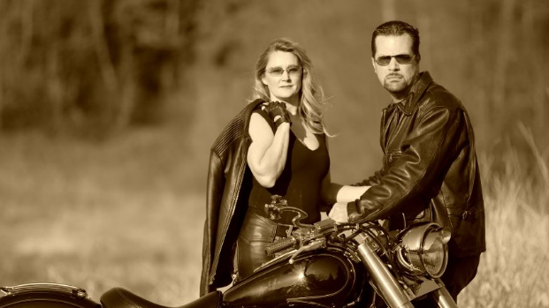
Genesis 3.21: The LORD God made
garments of skin for Adam and
his wife and clothed them.

Slide 16
Genesis 3.22-24 NIV: And the LORD God said, “The man has now become like one of us, knowing good and evil. He must not be allowed to reach out his hand and take also from the tree of life and eat, and live forever.” So the LORD God banished him from the Garden of Eden to work the ground from which he had been taken. After he drove the man out, he placed on the east side of the Garden of Eden cherubim and a flaming sword flashing back and forth to guard the way to the tree of life.

Slide 17
Genesis 3.14-24
Sermon materials at groben.com
artwork by Yezid Chiang Huaman

